Slide 1
Game Boy Development
Led by Will McGloughlin, Noah Stansbury, Luke Miller, and Cole Baughman

Slide 2
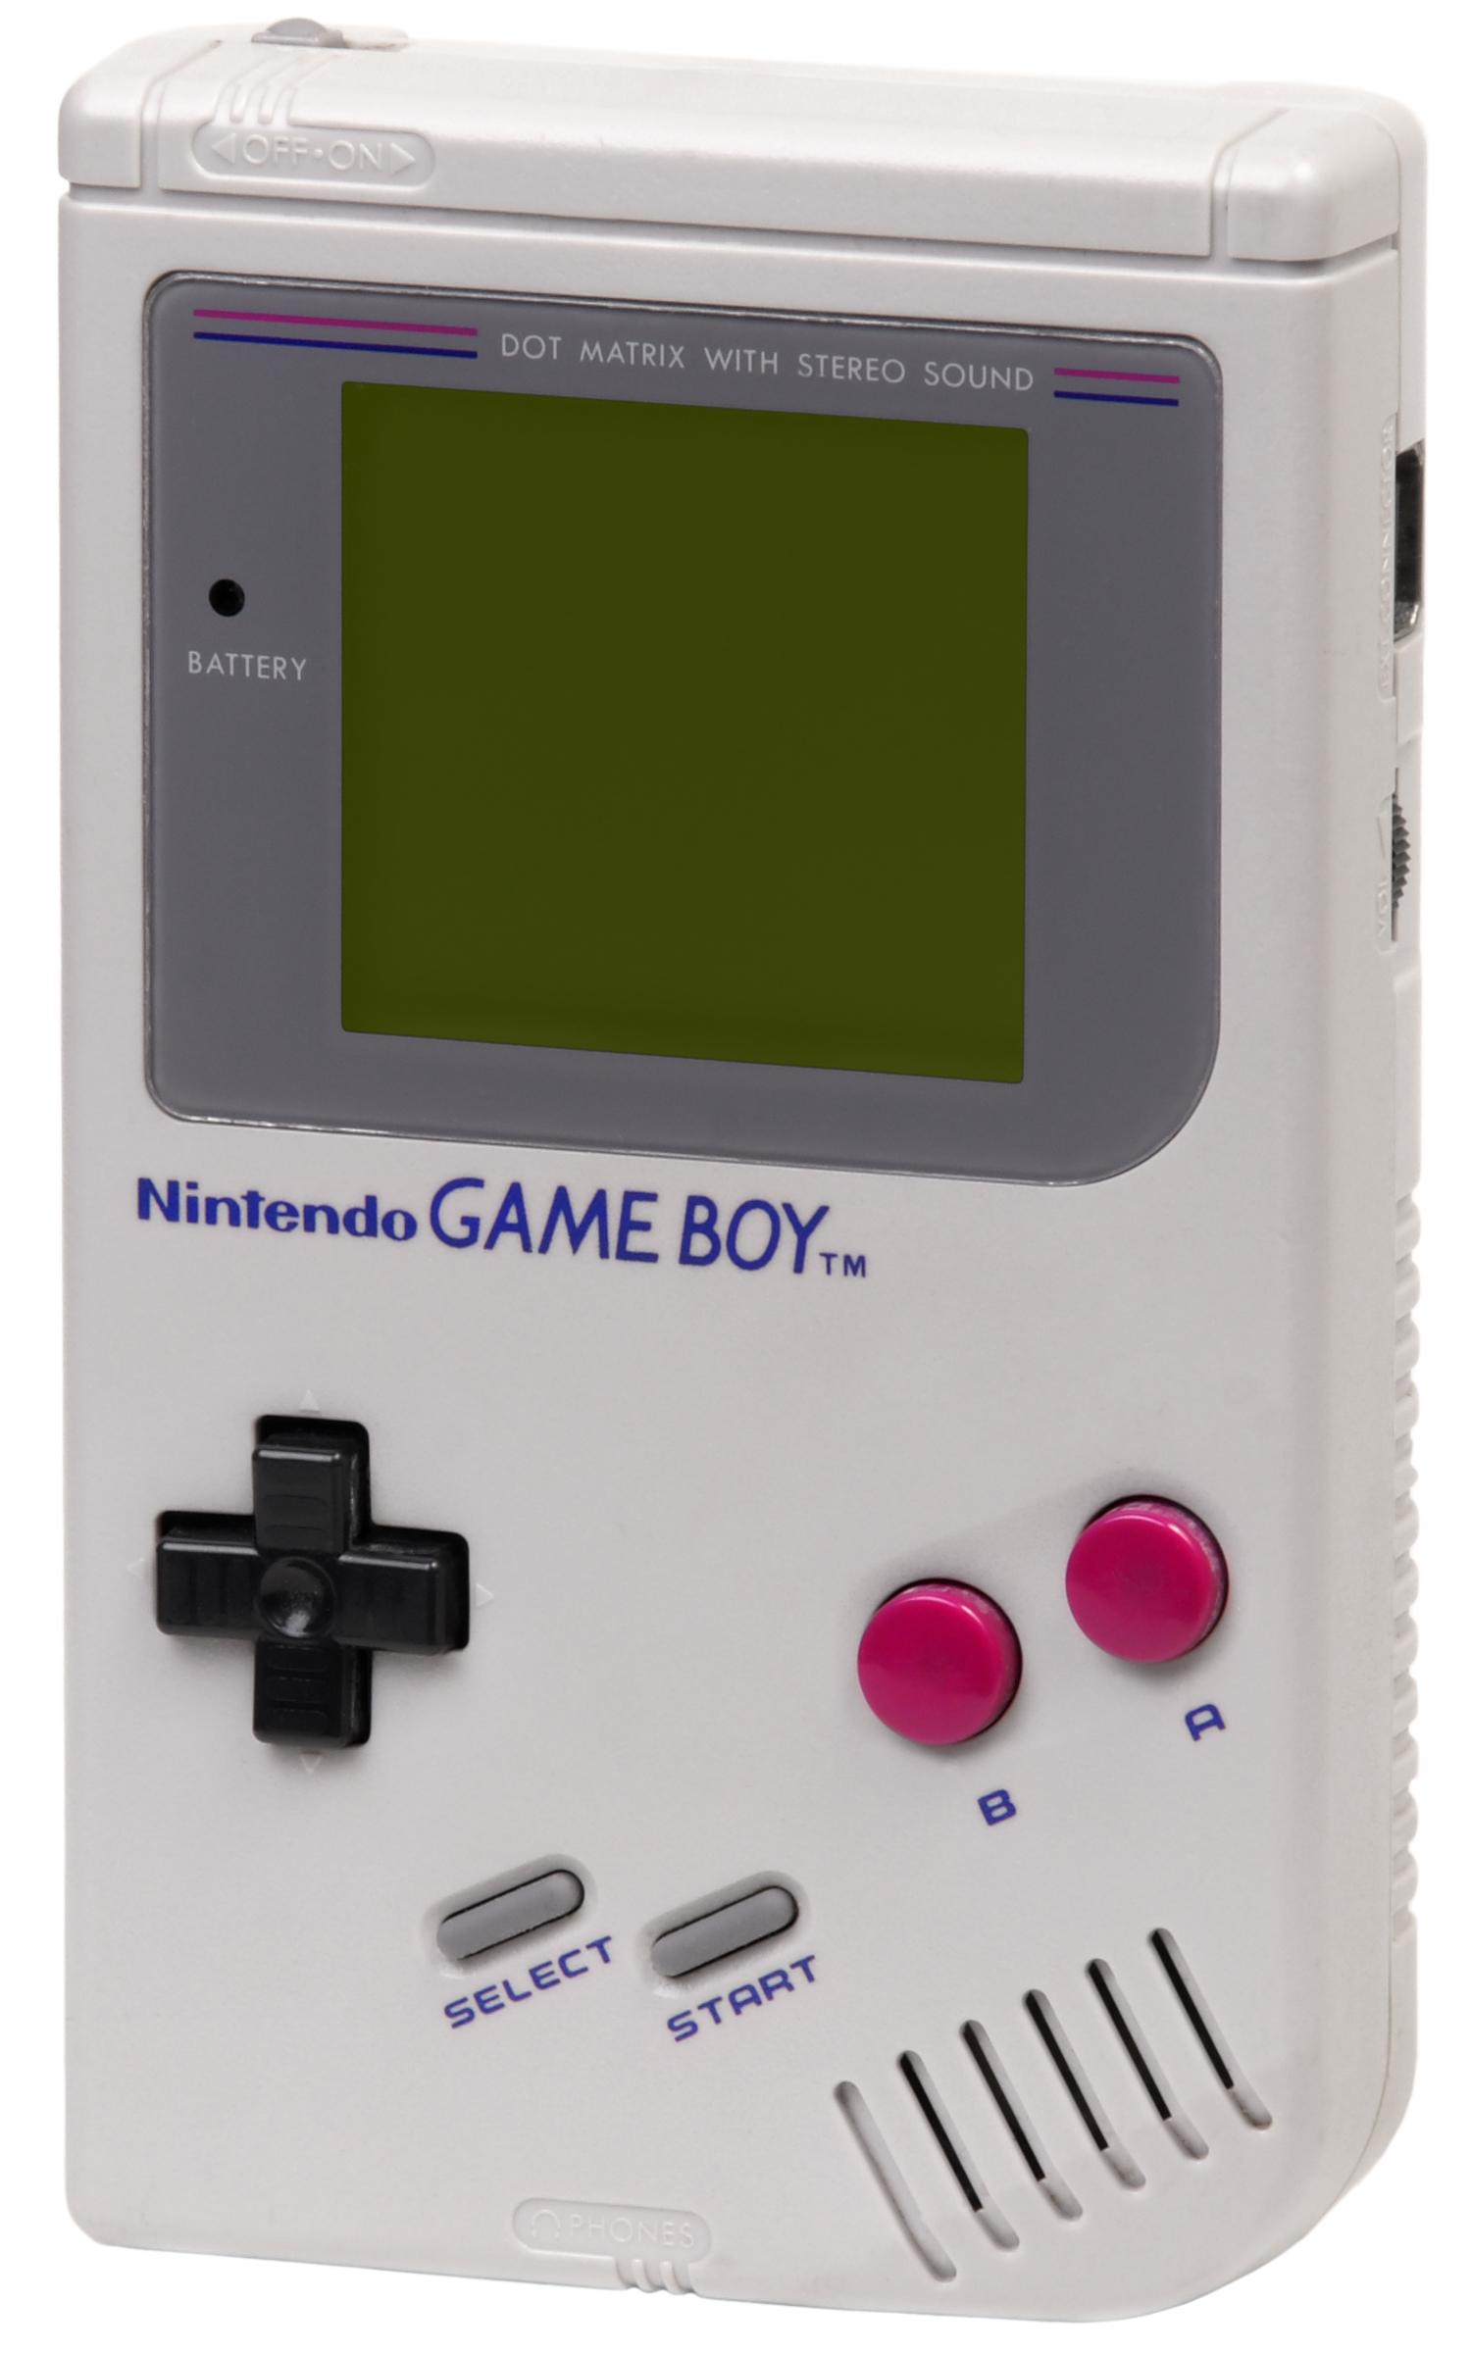
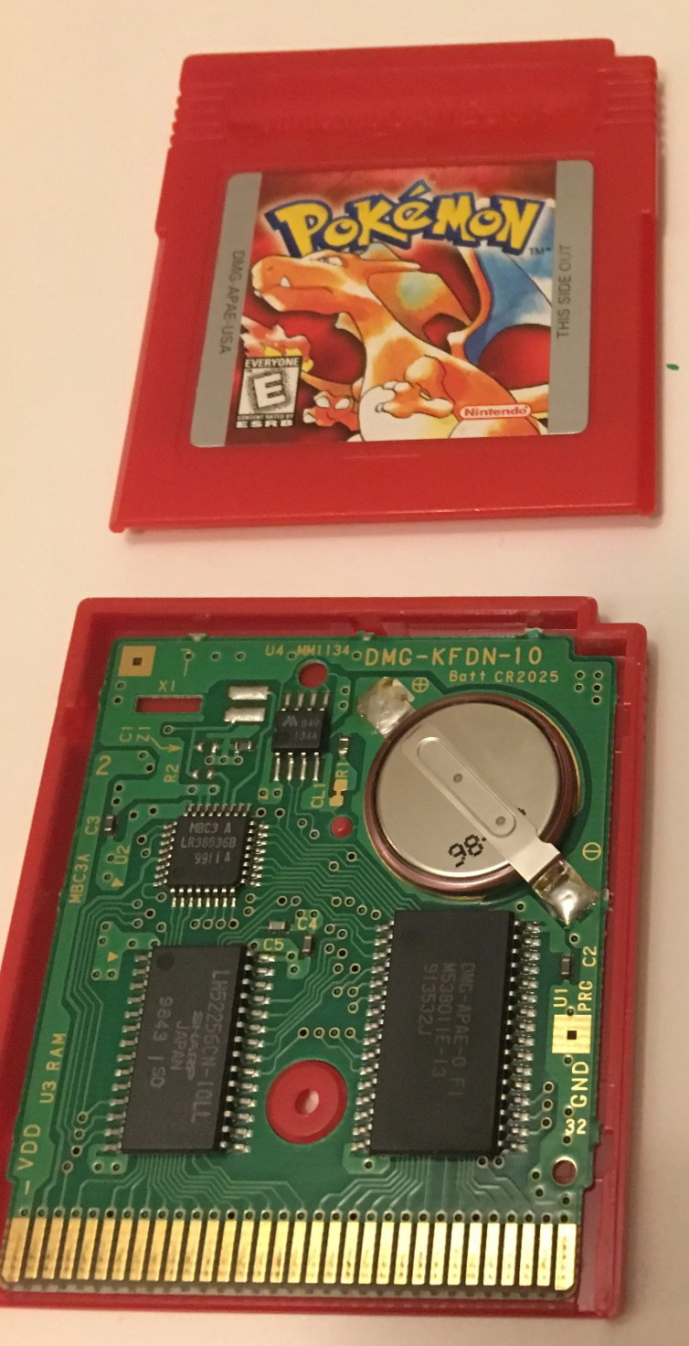
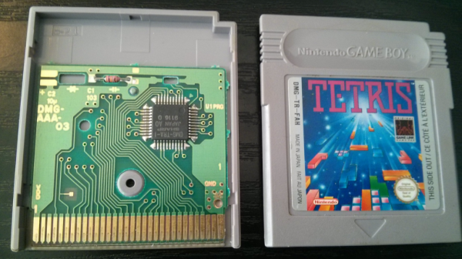
The Nintendo Game Boy
8-bit handheld game console released in 1989
Display
160x144 dot matrix
2-bit color (4 shades)
CPU
Sharp LR35902 (GBZ80)
Based on 8080 and Z80 processors of the time
Used a version of Assembly
Based on Z80 assembler
Memory
8KiB RAM built in
More might be in carts
8KiB RAM just for display
32KiB ROM in cart for game code
Misc
Graphical units called sprites

Slide 3
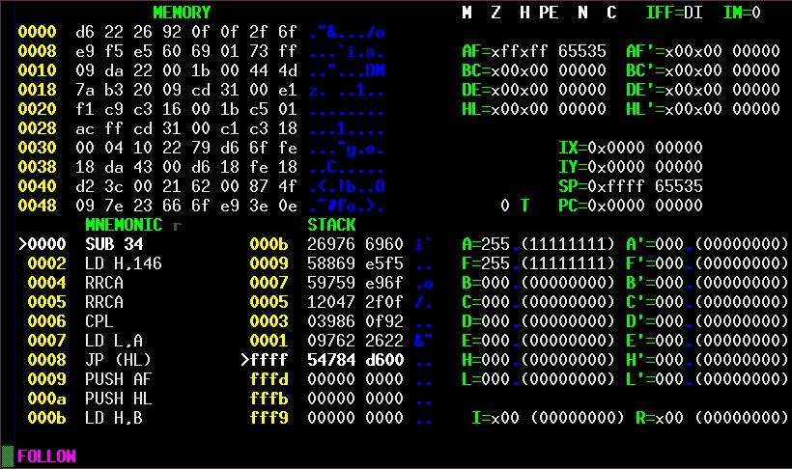
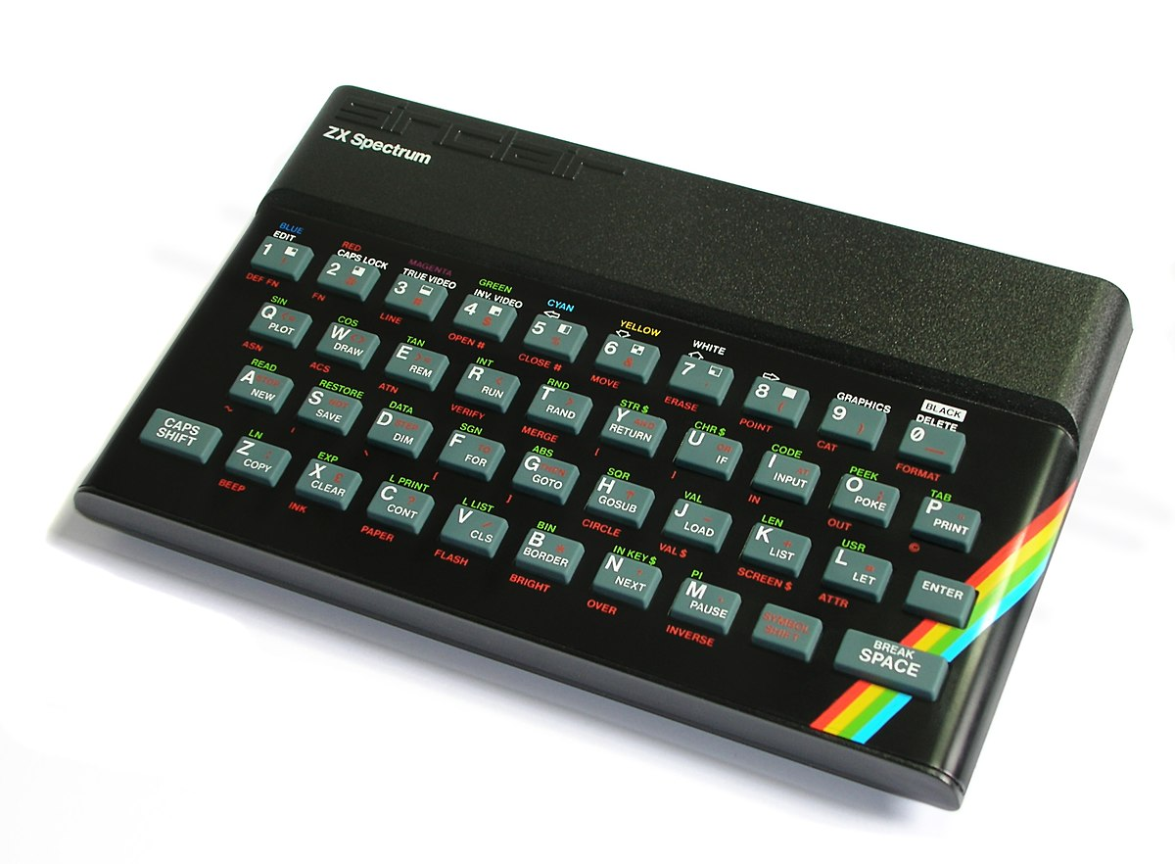
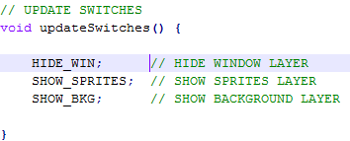
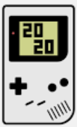
Programming
Programmers of the time would have had to learn GBZ80 asm
The Game Boy Development Kit (GBDK)
Rocky development
Development started late 90s
Abandoned early 2001
Rebooted in 2020
Compiles C into asm that the Small Device C Compiler (SDCC) can understand
In short, you can make Game Boy games with C!
Your code
You’ll write code in main.c
Everytime you make changes, run make.bat
This will turn your code into a .gb rom file
Make sure to run make in the same folder as the gbdk
Run the .gb file with VisualBoyAdvance

Slide 4

C Background
C is a lower level programing language compared to the languages you may know like Python or Java
Python allows us to be more flexible, for example variable types can be determined at runtime by the data assigned to them
C code lacks this flexibility
C must be compiled before it can be run
In this workshop we have given you the file make.bat it will compile your C code into .gb files for the emulator
We are going to go over some syntax you’ll need to know for your development
Notes:
GBDK for macos:
KiGB: https://www.macupdate.com/app/mac/11018/kigb/download

Slide 5
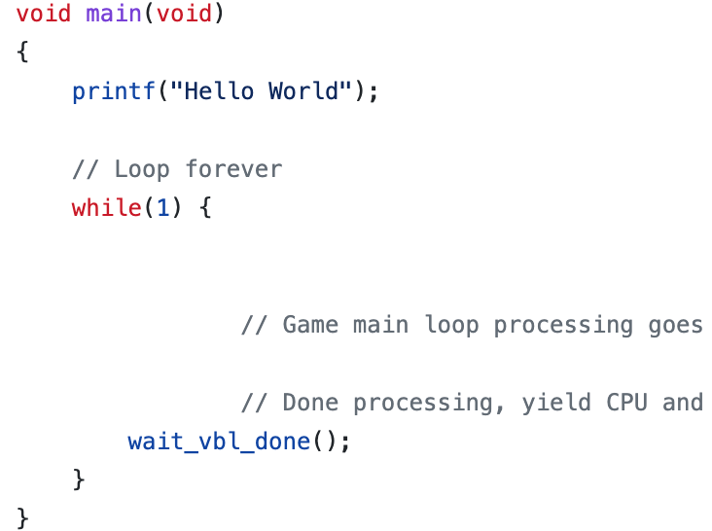
C Syntax - Semicolons and Variable Types
For this workshop we will be using statements similar in nature to ones you know from other programing languages
Syntax of those statements will be different
For example:
Every non blocking statement must end with a semicolon ;
This would not include statements like if or while, the are followed by brackets {} containing the statements to be executed by them
Variables must be declared with a type
int x;
int y = 4;
float i = 3.4;
Print using printf(“Text to be printed”);

Slide 6



C Syntax - Main Function and Other Functions
Similar to Java, C runs code that is inside the main function
From here you can call other functions
They may be in the same .c file or other .c files
In C it is customary to have header files that outline functions used in the program
Implement functions in a .c file of the same name
Include these header files and other files in main.c with include statements at the top of the program like #include “block.h”
Instantiates functions
Implements functions
Functions called in

Slide 7
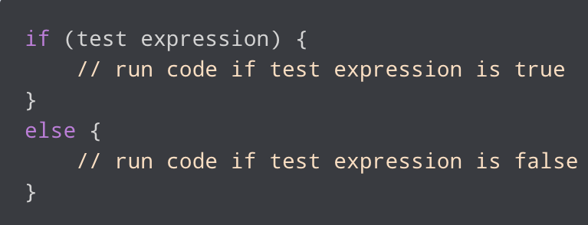
C Syntax - If-else Statements
For this workshop need to know if statements
Similar syntax to Java
Possible conditional operators used in this workshop include
== equals
!= not equal
&& and
|| or
> greater than
< less than

Slide 8
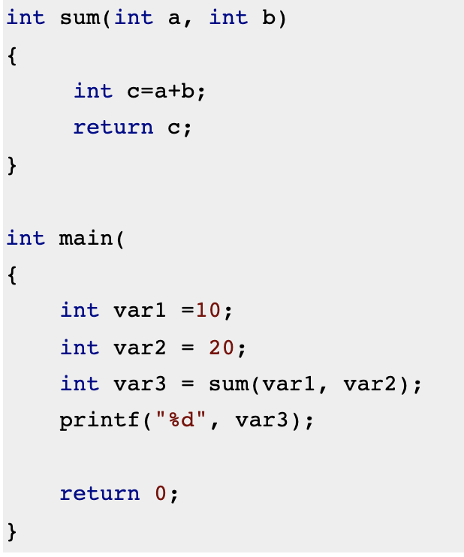
C Syntax - Calling Functions
Calling functions is similar to Java
Functions for this workshop are created by GBTD
We will need to call them in main
Also, we will need to supply them with arguments if the function requires them
For example a function with two arguments
function_name(argument1, argument2);
Calling a function with no arguments leaves the parentheses blank
function_name();

Slide 9
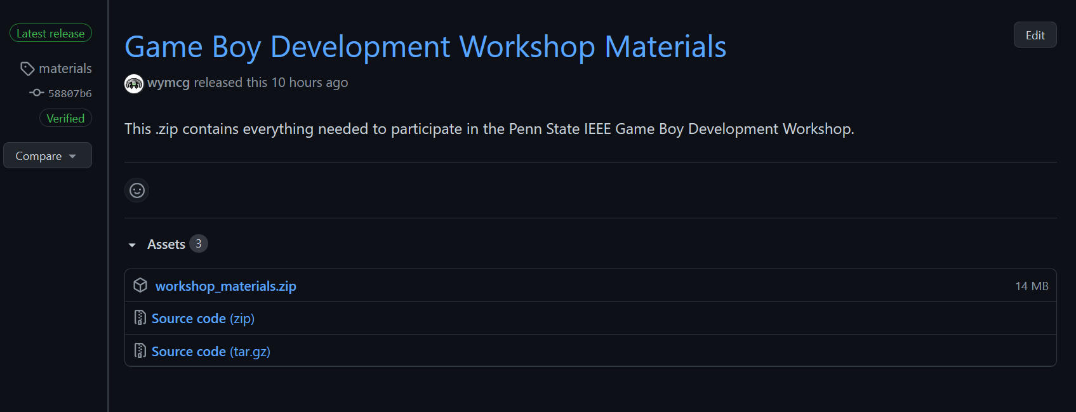
Download workshop materials
Navigate to https://github.com/psuieee/projects2021/releases
Download workshop_materials.zip
Extract the contents to an easy-to-find place

Slide 10
Hello, World!

Slide 11
A word on GBTD

Slide 12
Getting your sprite on screen

Slide 13
Getting that sprite to move

Slide 14
Final changes

Slide 15
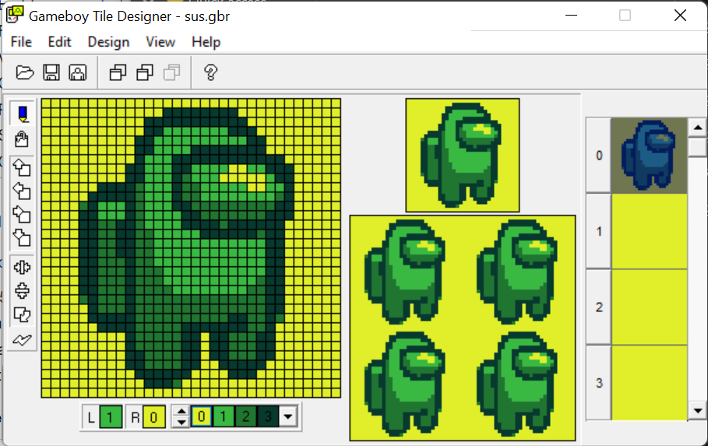
Next Steps
Background tiles
Multiple Sprites
Larger sprites
Sprite groups
Sound
See GBDK documentation!

